Slide 1

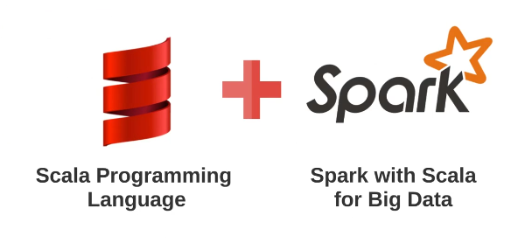
Scala and Spark for Big Data BUS6305 : Preparation and Analysis of Big Data

Slide 2
Scala and Spark for Big Data
Community Edition
Free – Setup by Databricks for the purpose of training Spark users
6 GB Processing 4 GB Storage
Runs on Amazon EC2 instances with Spark nodes already set up for you, clusters shut down automatically in 2 hours
Best practice is to consider uploaded data not private
Databricks Notebooks allow you to code in Python, R, Scala, & SQL
Focus of tonight is to show you a high level overview of what the tool is capable of and how you could use it

Slide 3
Scala and Spark for Big Data
Spark
Processing done in memory
100x faster than MapReduce (when all data can fit in memory)
10x faster than MapReduce (when not all data can fit in memory)
Transformations and Actions – Only two operations done by Spark
Transformations are operations that will only get executed once you have called a action. (Considered Lazy due to not using computational power)
Actions are commands that are computed by Spark right at the time of their execution.
Let’s get into Databricks

Slide 4

Scala and Spark for Big Data

Slide 5
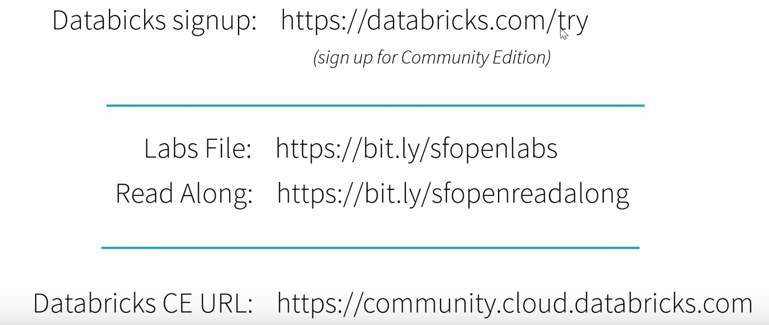
Scala and Spark for Big Data
No credit card required
No setup required on laptop
Apache Spark cluster running on A
Remember two lab links

Slide 6
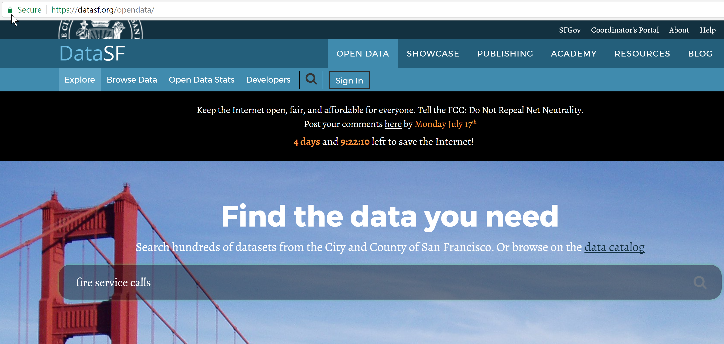
Scala and Spark for Big Data

Slide 7
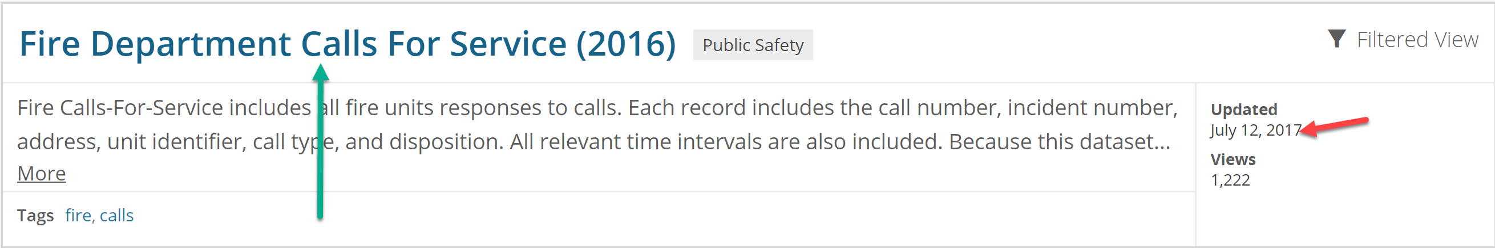
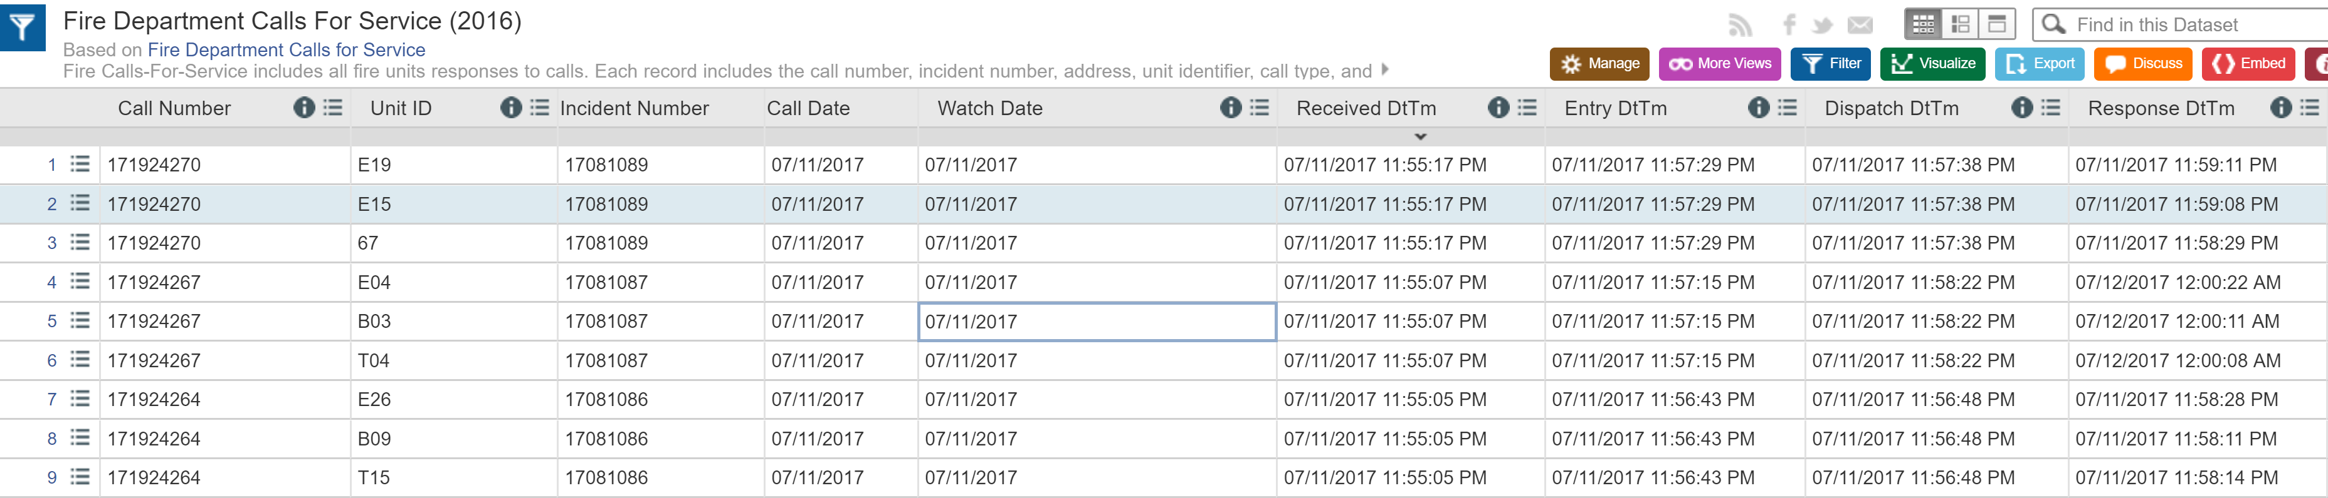
Scala and Spark for Big Data
Click on link and data munge report columns

Slide 8
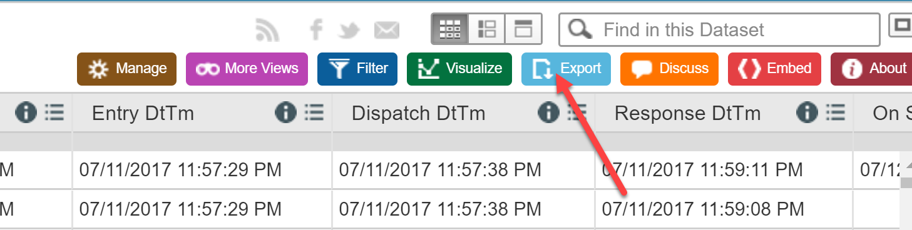
Scala and Spark for Big Data
Download the data

Slide 9
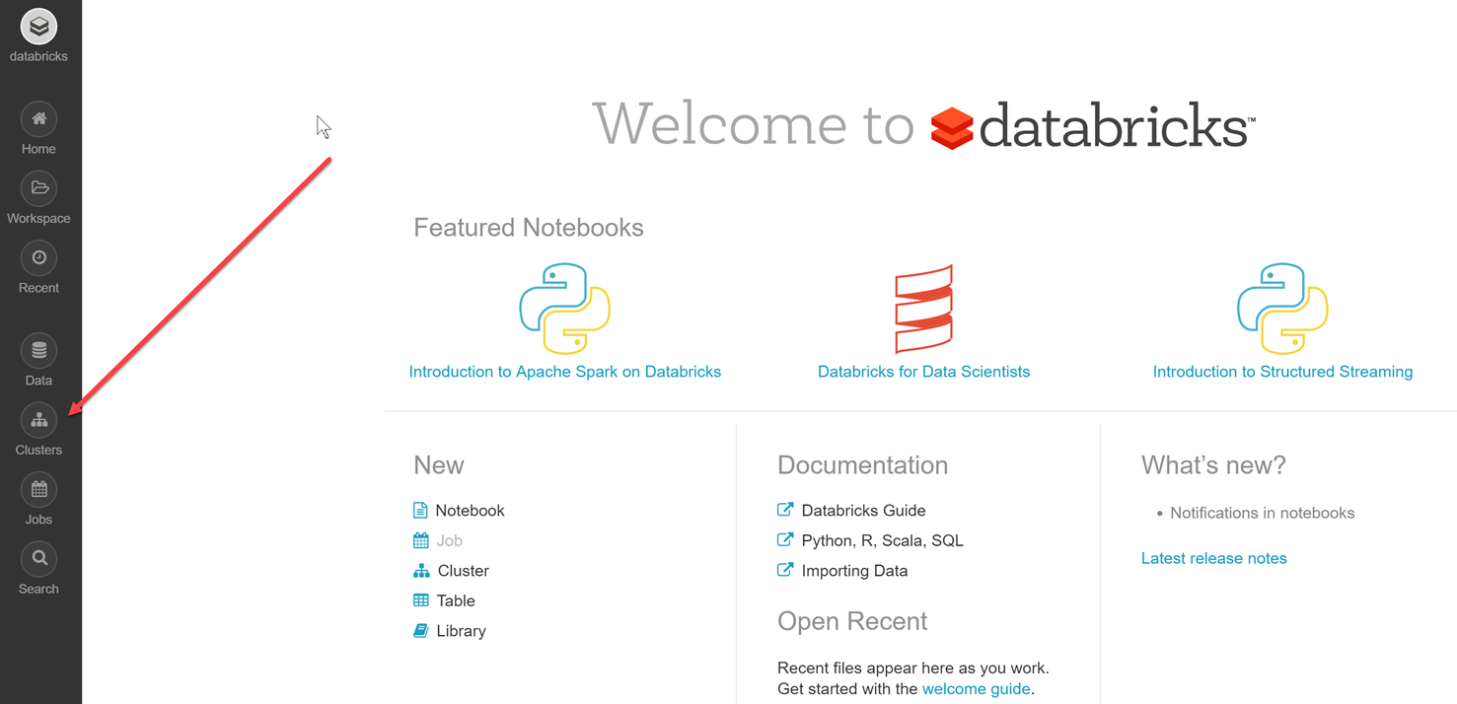
Scala and Spark for Big Data
Login and launch an Apache Spark 2.0 cluster

Slide 10

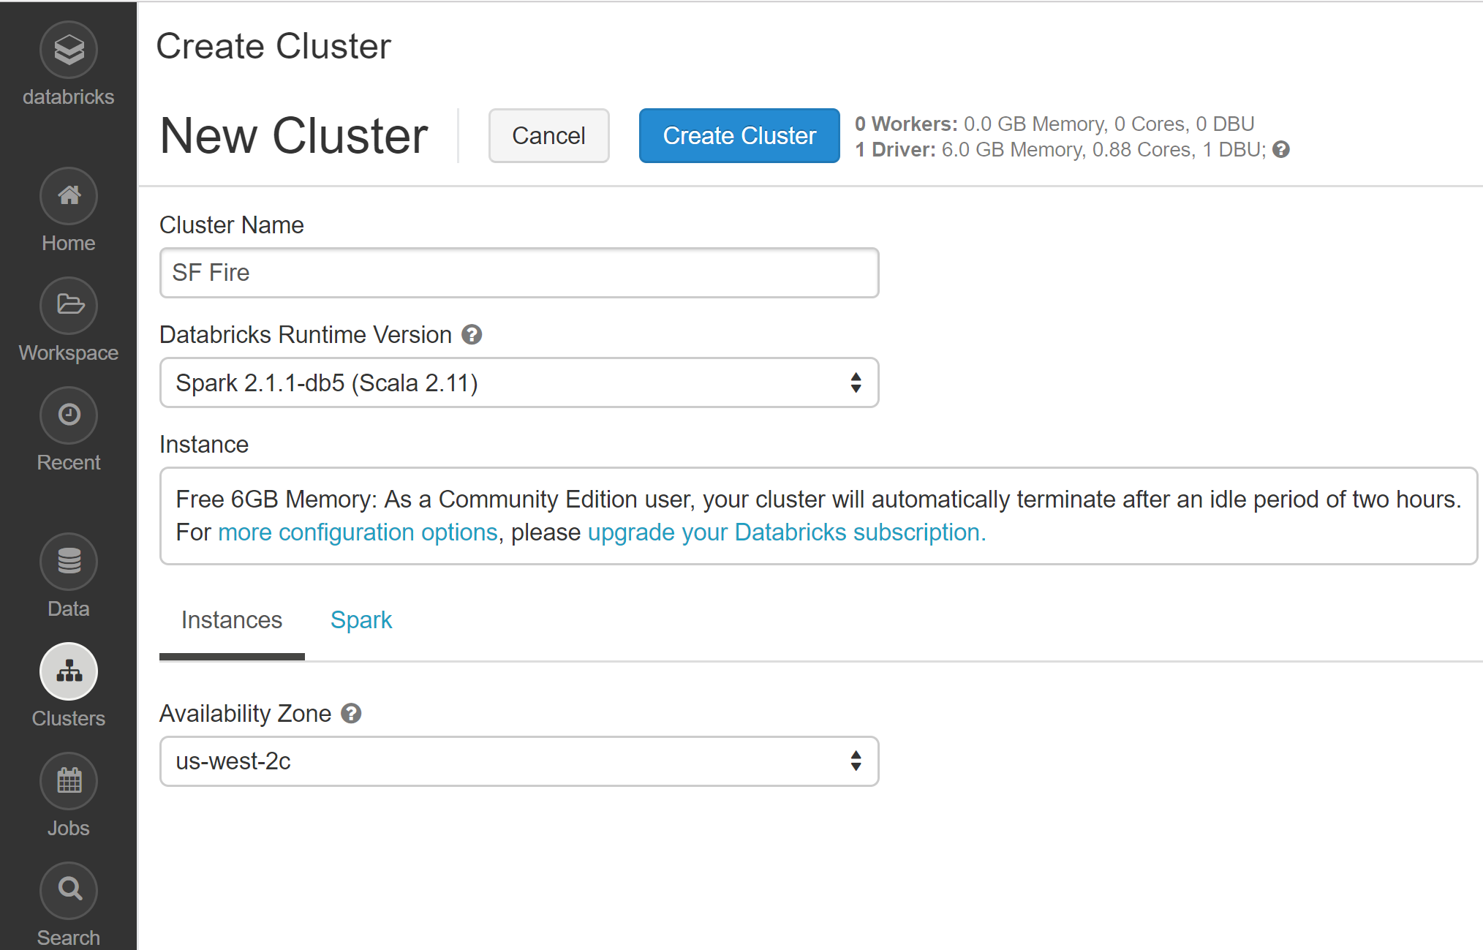
Scala and Spark for Big Data
Click on , Name Cluster,

Slide 11
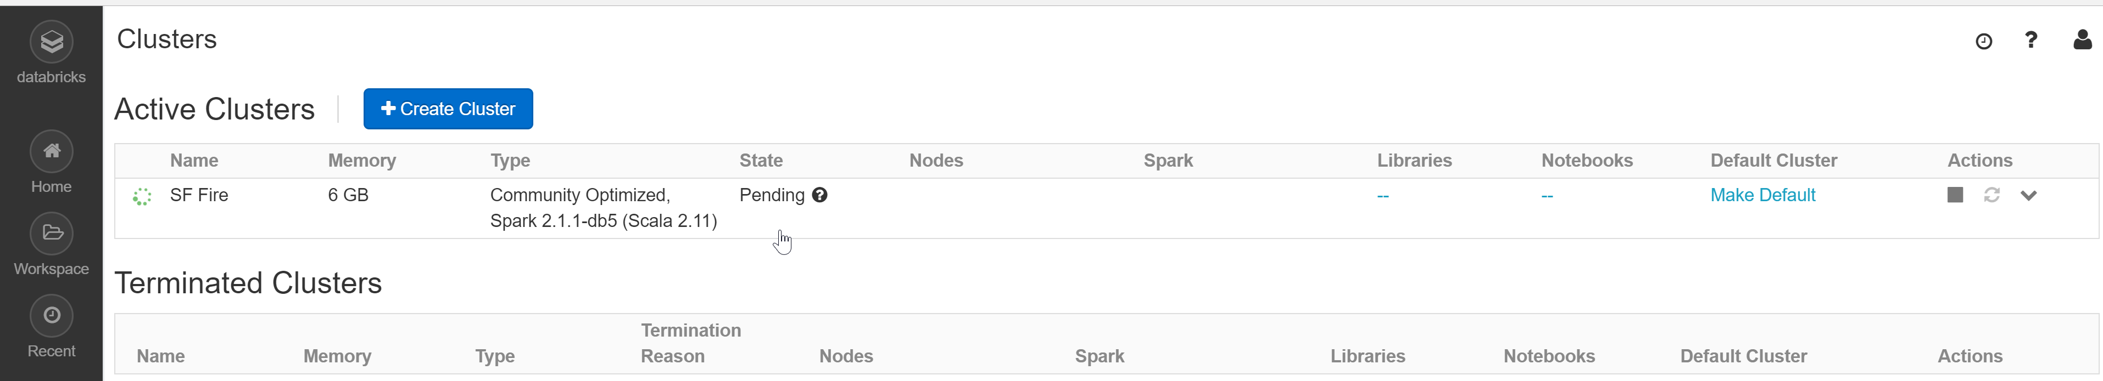
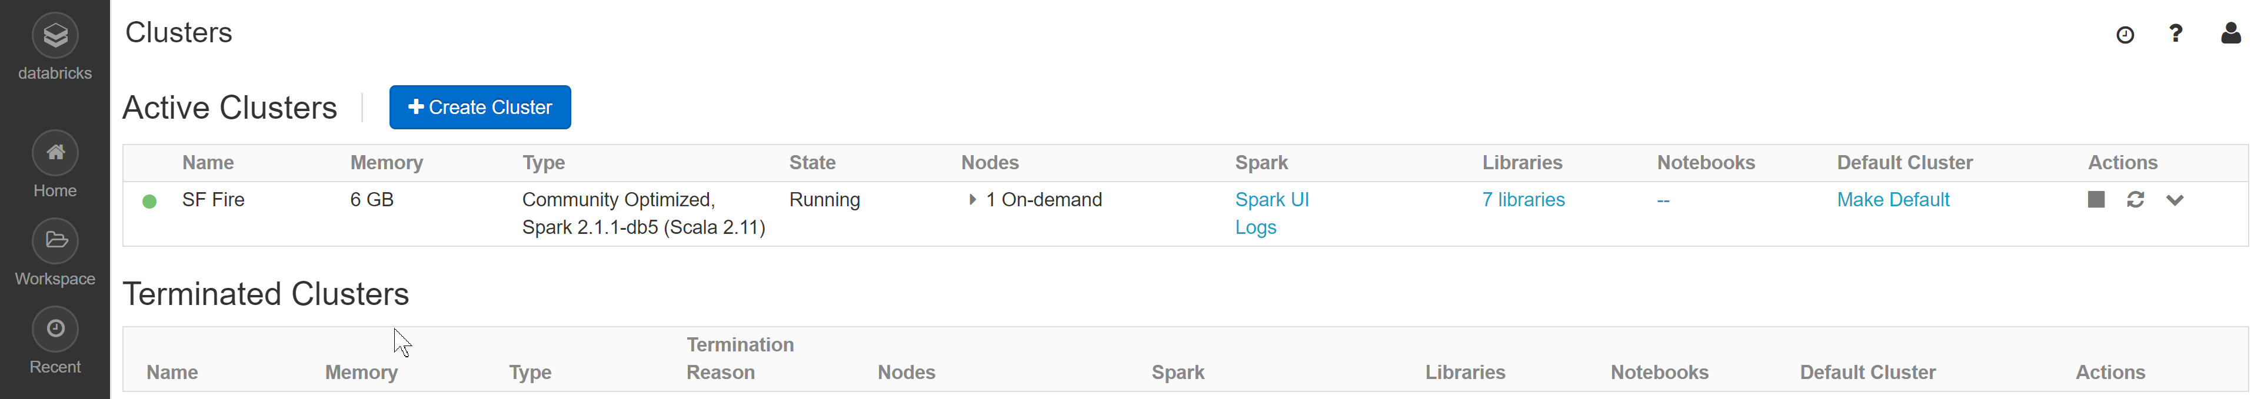
Scala and Spark for Big Data
In process validation
Cluster successfully created

Slide 12
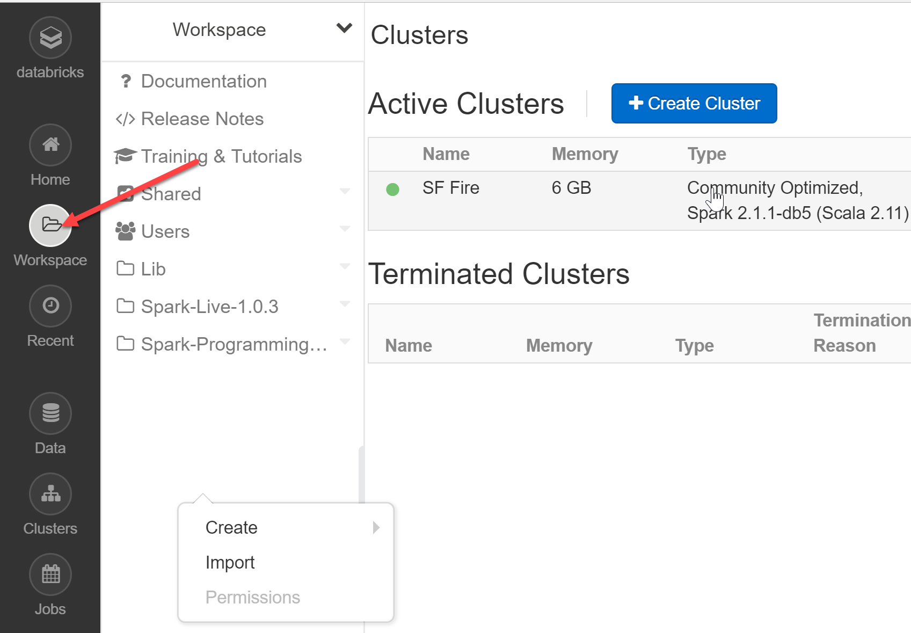
Scala and Spark for Big Data
Open Workspace, Right click in white space, Import data

Slide 13
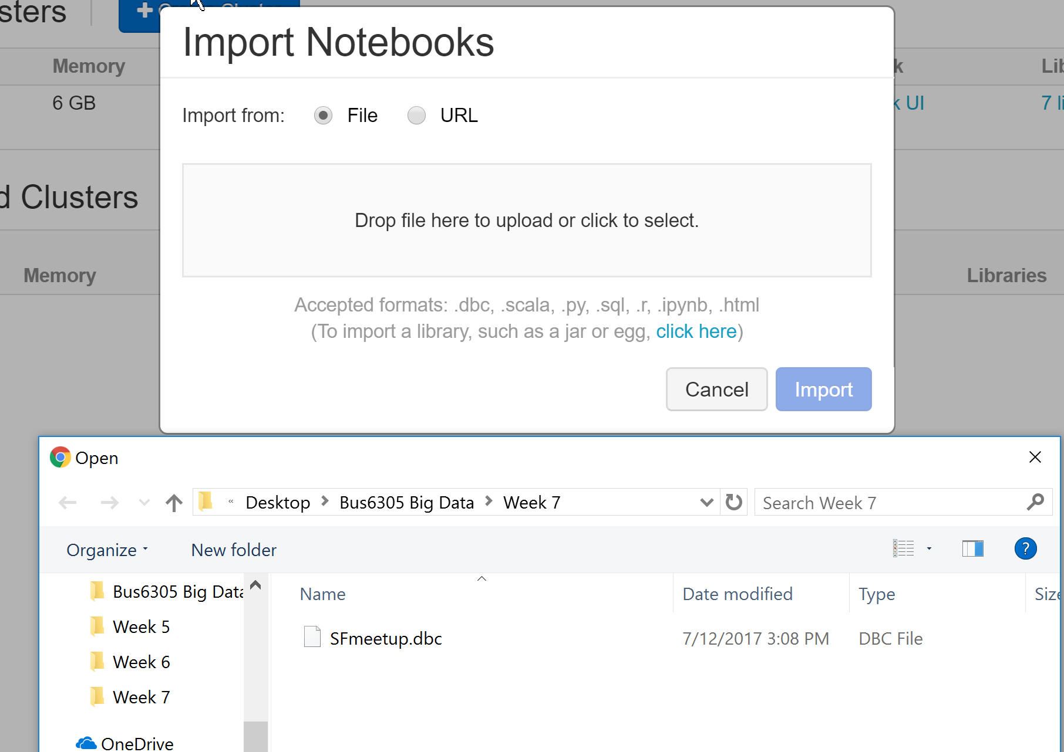
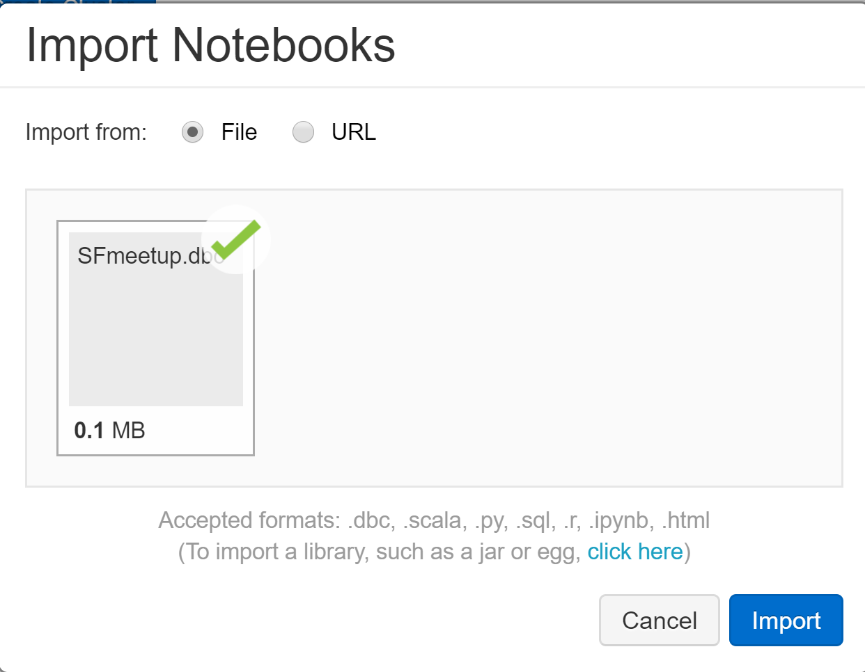
Scala and Spark for Big Data
Browse for file, open and import

Slide 14
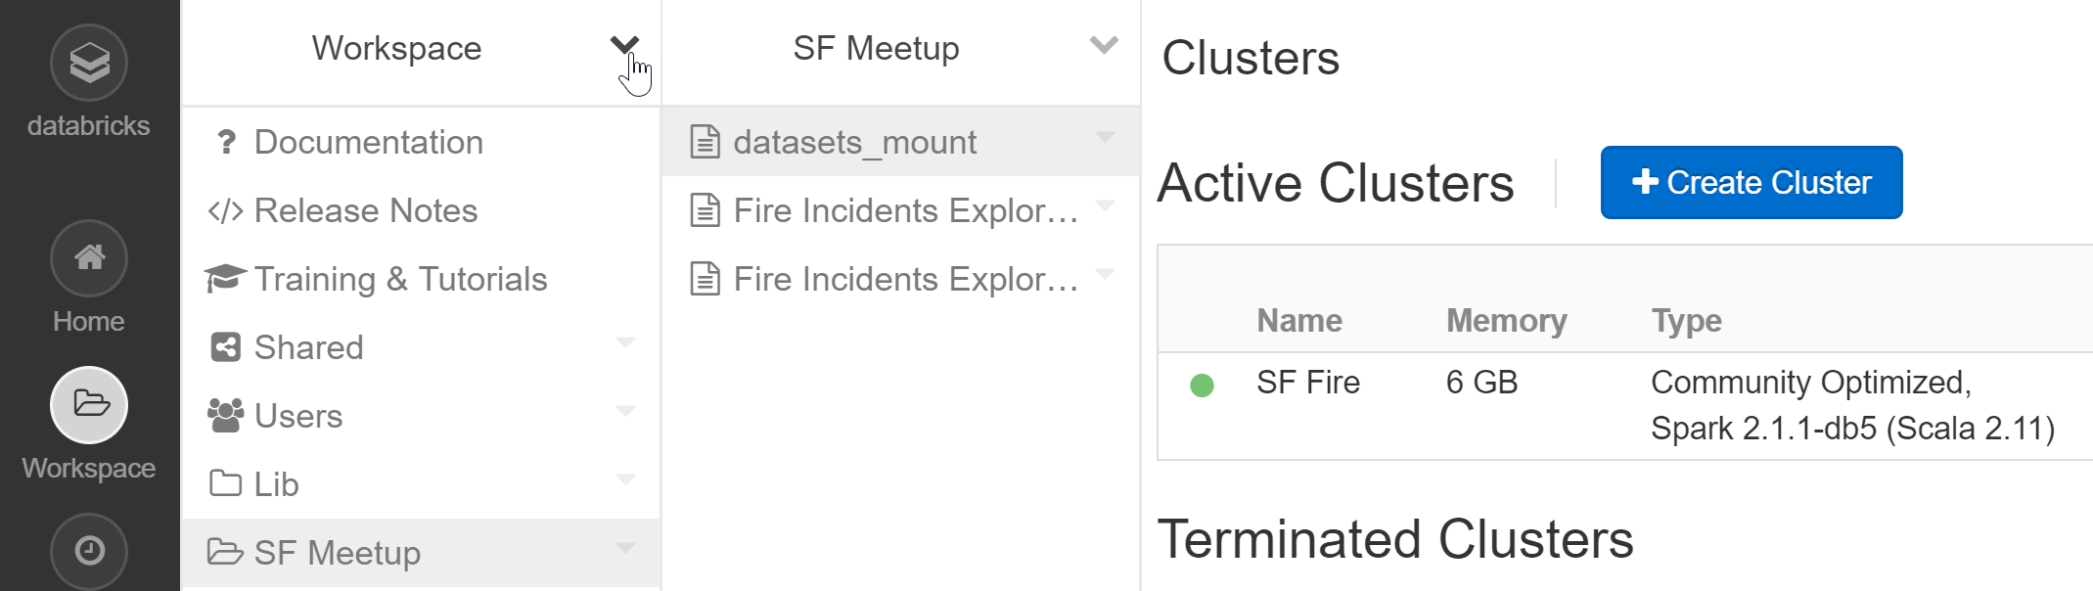
Scala and Spark for Big Data
File now visible on Workspace
Click on SF Meetup, datasets_mount

Slide 15
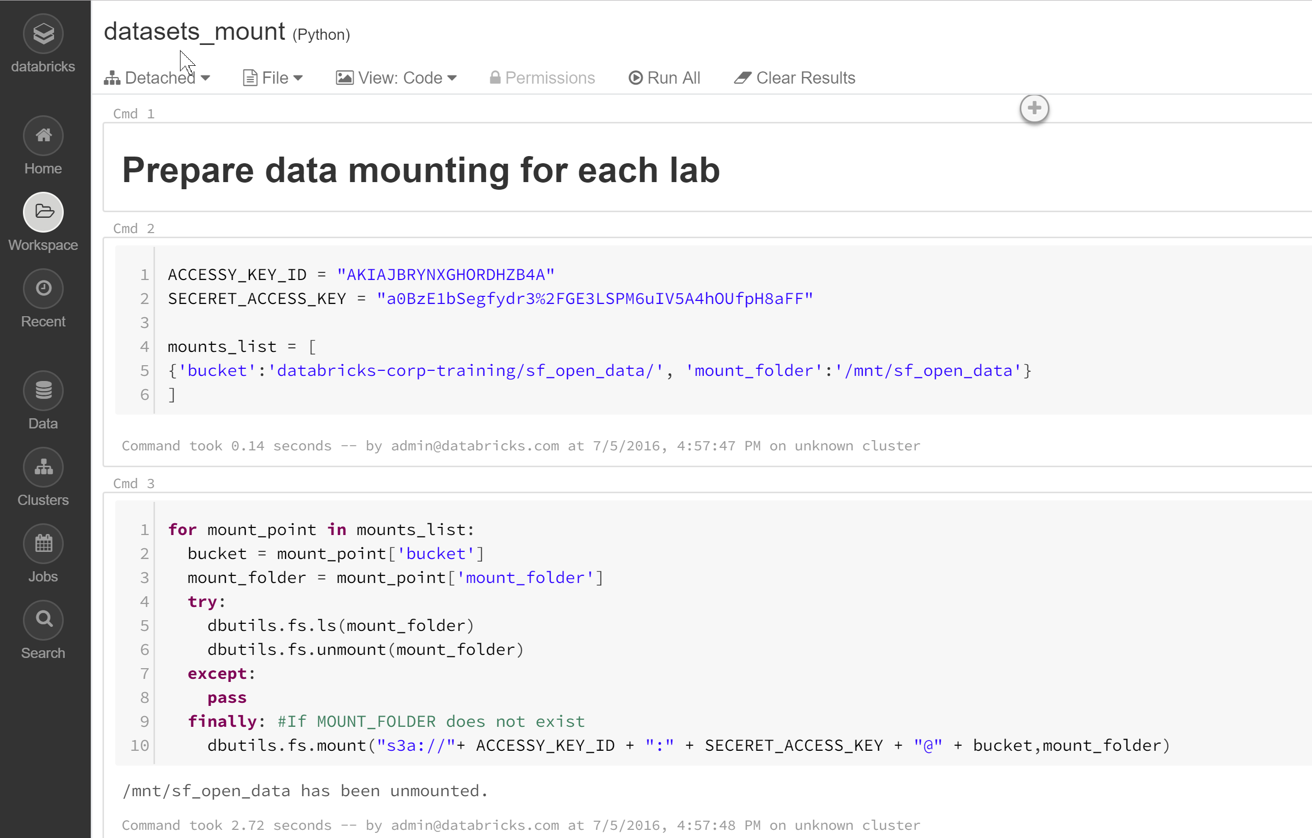
Scala and Spark for Big Data

Slide 16
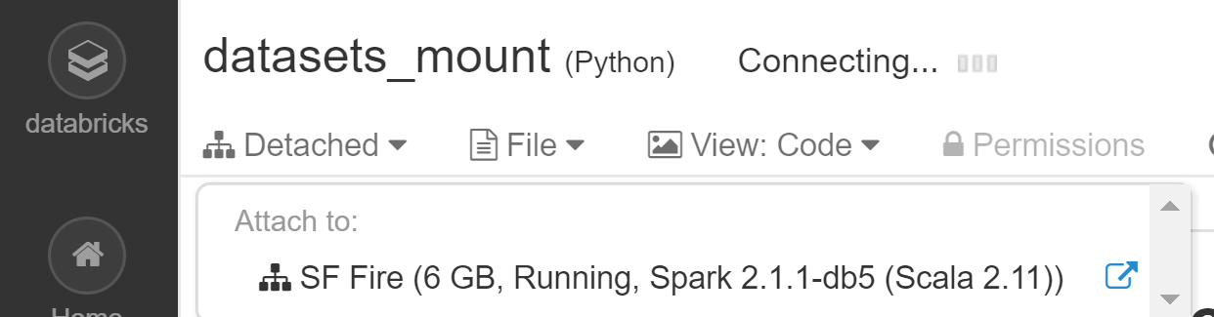
Scala and Spark for Big Data
Click on Detached
Attach notebook to your cluster

Slide 17
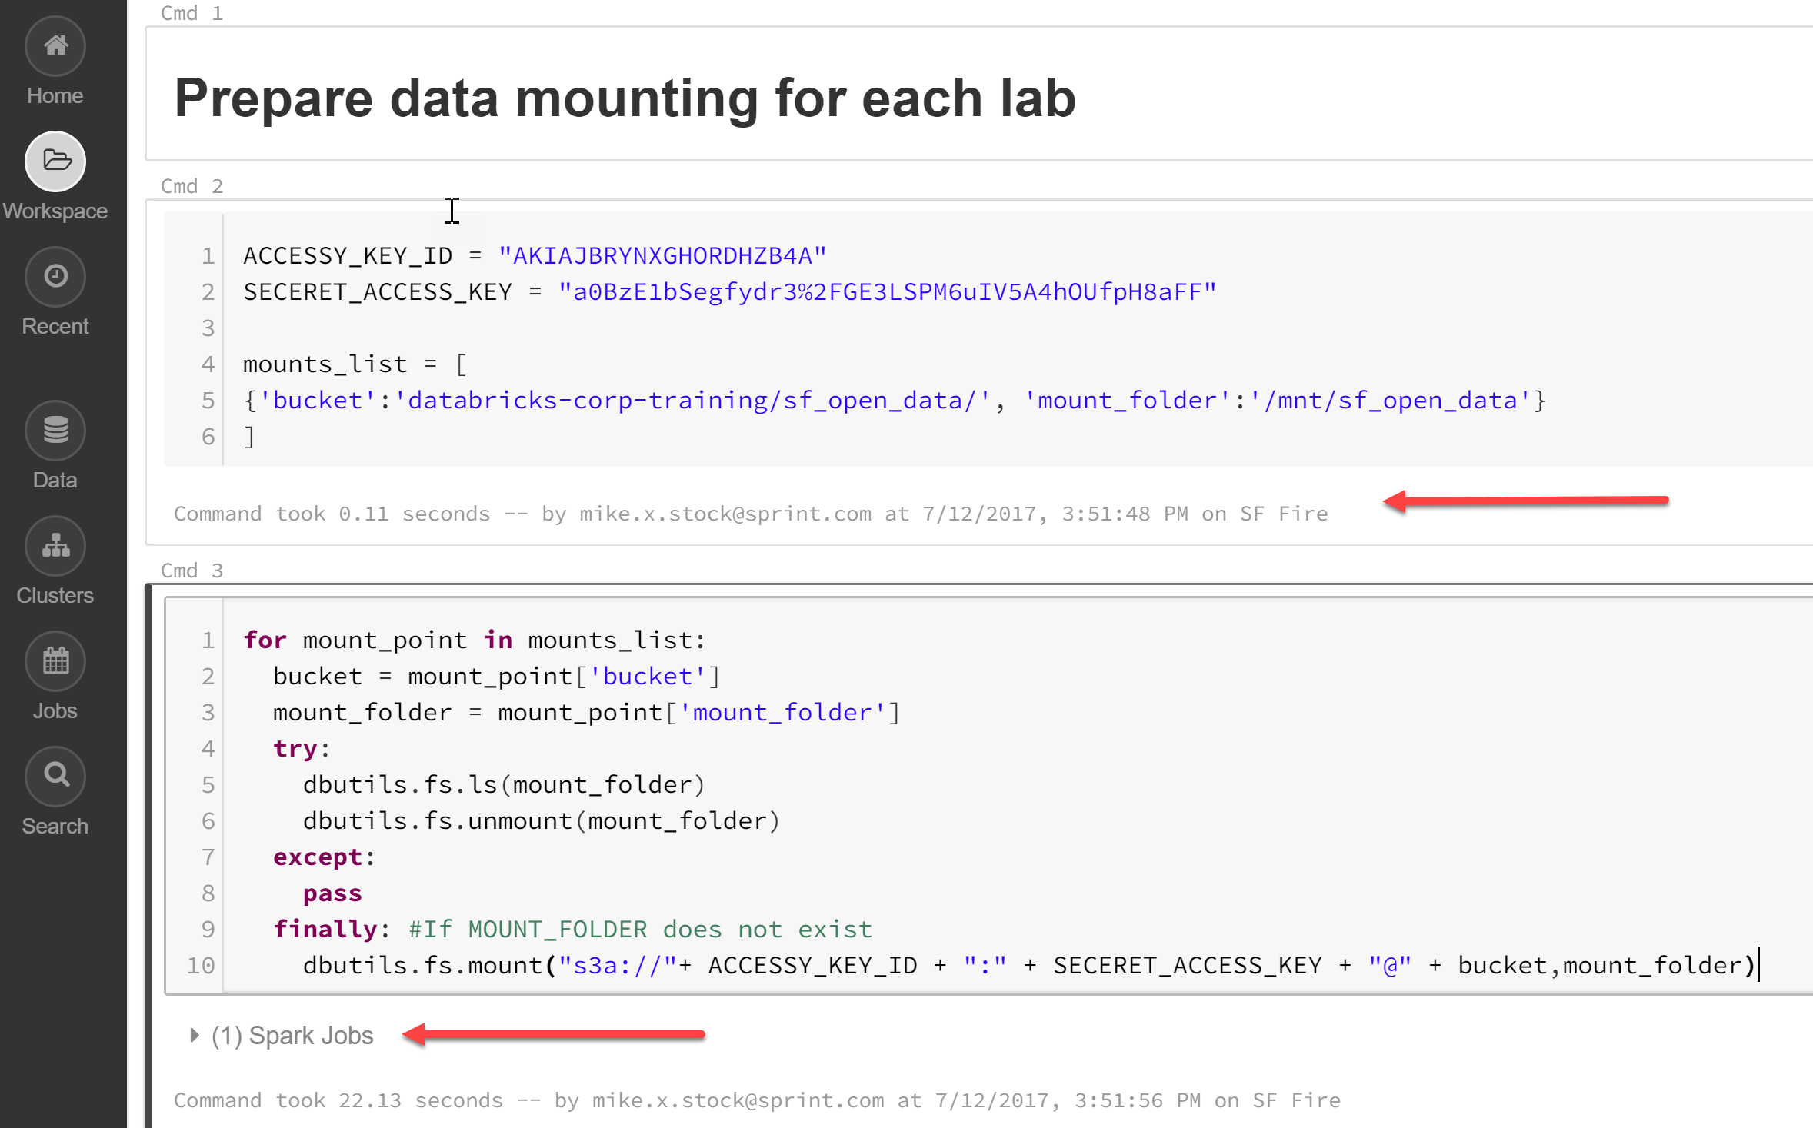
Scala and Spark for Big Data
Select each cell and hit Shift>Enter to execute each code block

Slide 18
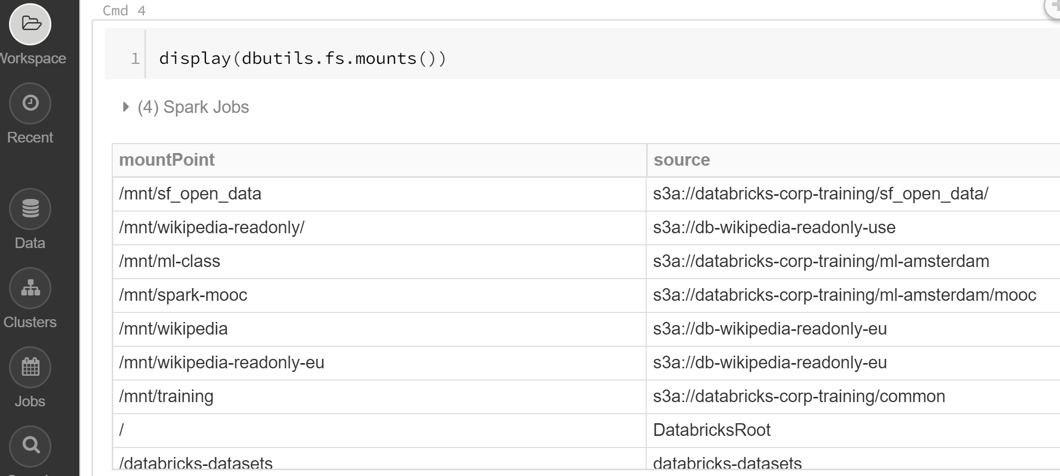
Scala and Spark for Big Data
Execute third block and code and see mountpoint information

Slide 19
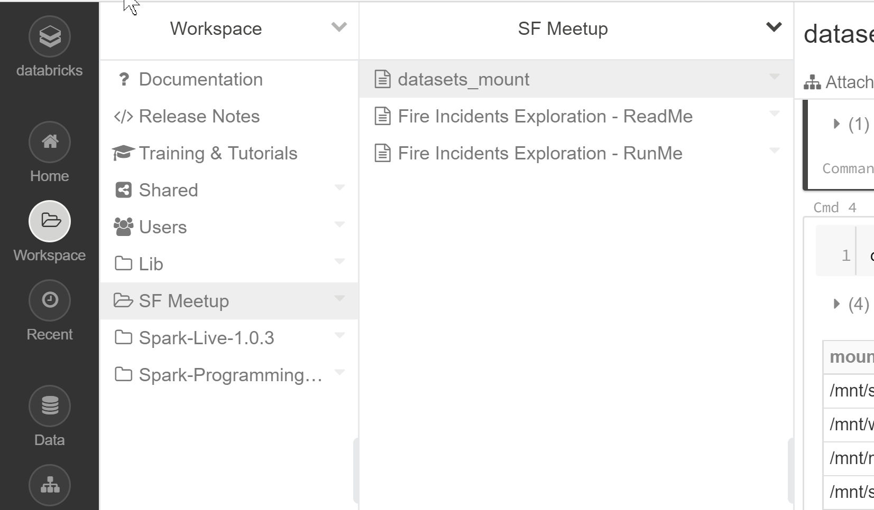
Scala and Spark for Big Data
Open Workspace, Evaluate ReadMe and RunMe Notebooks

Slide 20
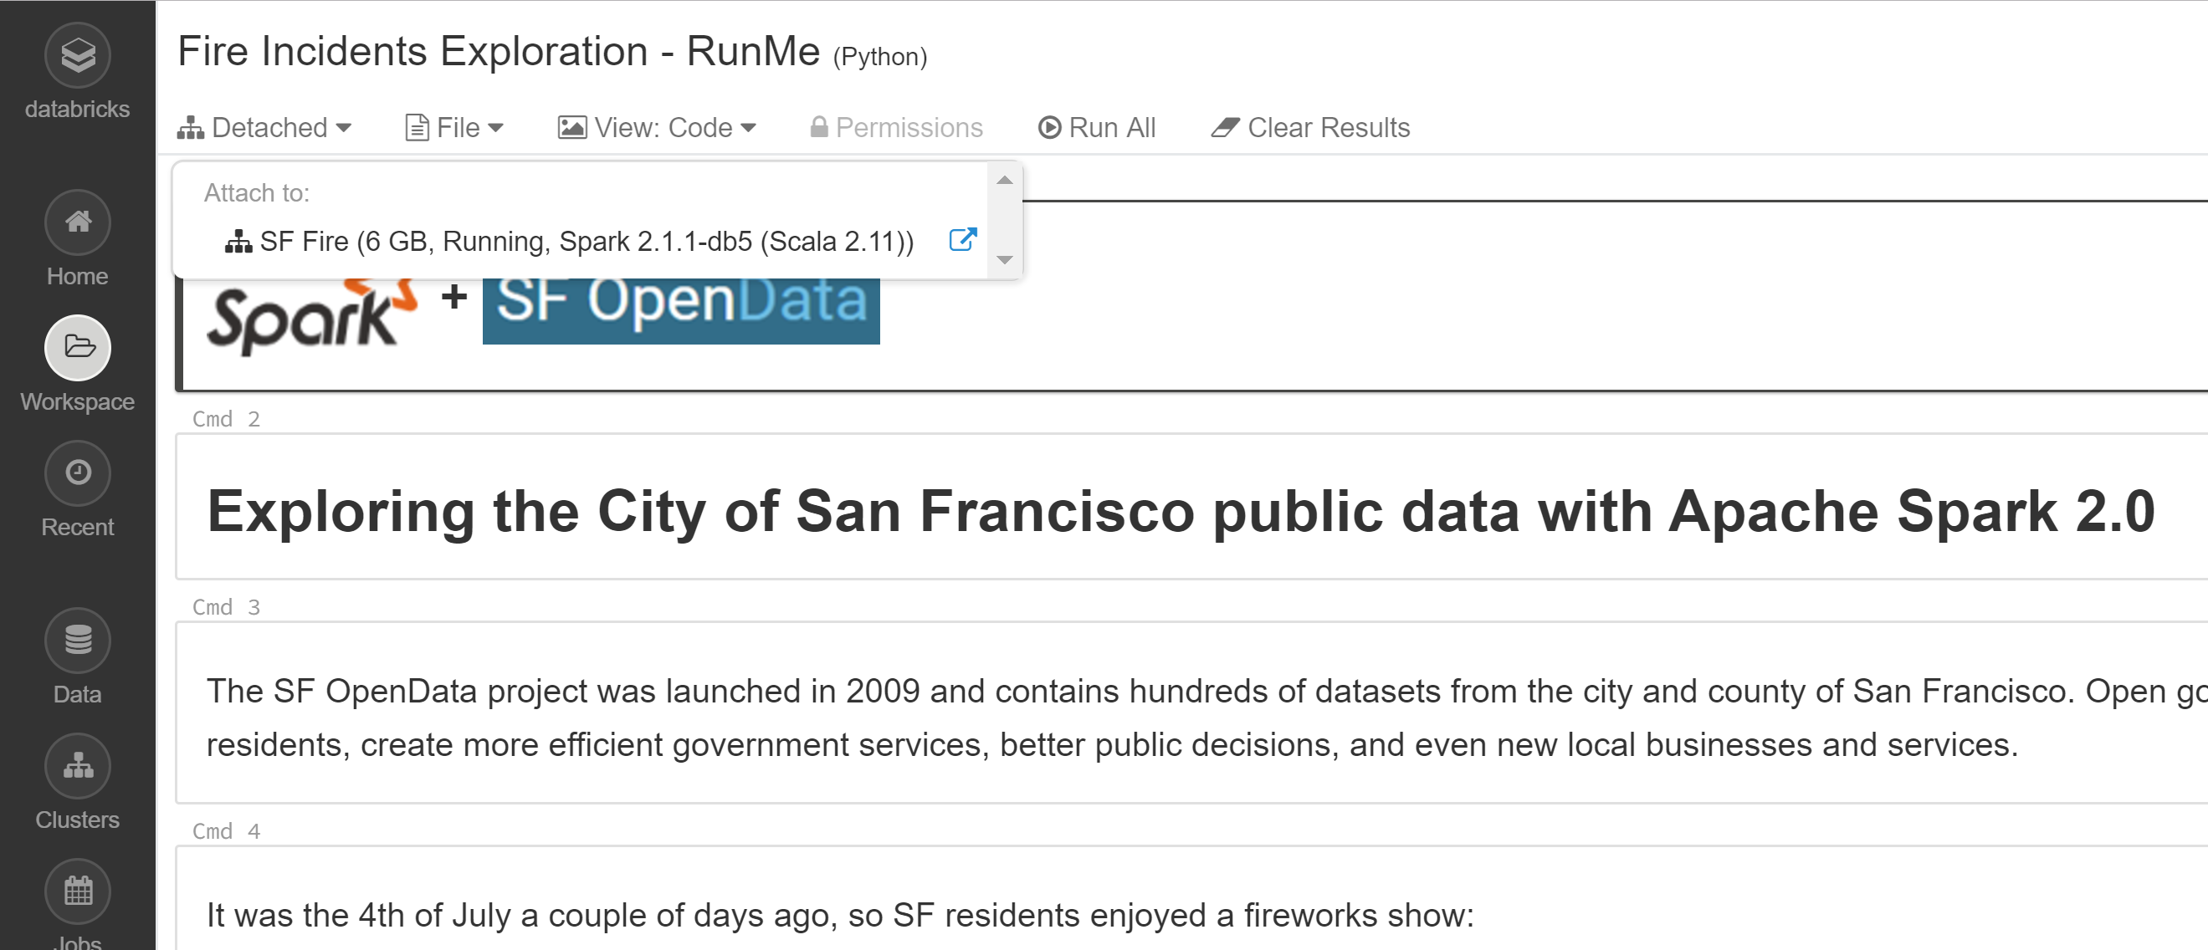
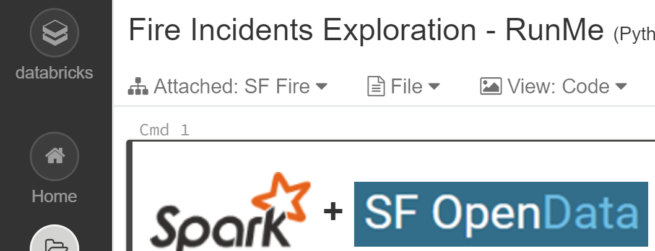
Scala and Spark for Big Data
Click on RunMe Notebook and attach to your cluster

Slide 21
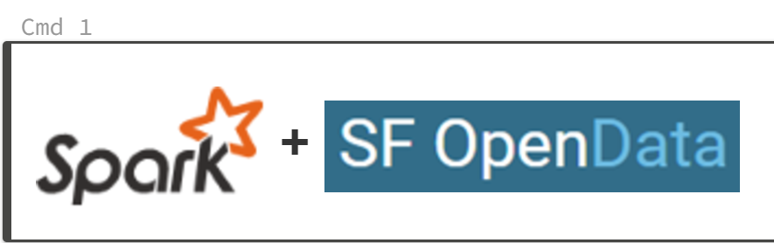
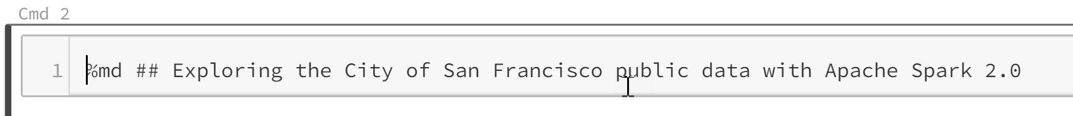

Scala and Spark for Big Data
Doubleclick on
Notice images are actually a markdown file

Slide 22
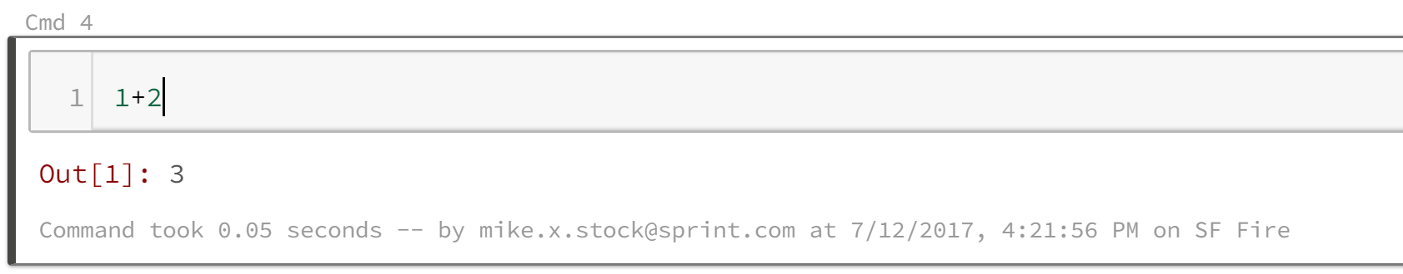
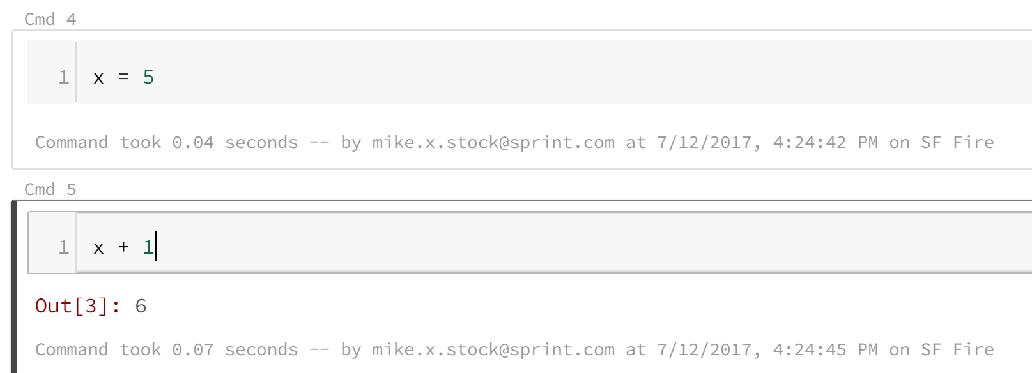
Scala and Spark for Big Data
Click on Keyboard Icon
Click on + sign between cells, right python code and execute
Shortcuts to know: Shift>Enter, Ctrl>Enter

Slide 23
Scala and Spark for Big Data
Assignment 6:– Articles related to Spark
Each write up below needs to be between ½ to 1 page in length in a Word document with 1 inch margins and 11 point font.
The Big 'Big Data' Question: Hadoop or Spark?
Read the following article and submit a written overview of what was learned from the reading
https://www.linkedin.com/pulse/big-data-question-hadoop-spark-bernard-marr
What is Apache Spark? The big data analytics platform explained
Read the following article and submit a written overview of what was learned from the reading
https://www.cio.co.ke/news/apache-spark-big-data-analytics-platform-explained/
The future of the future: Spark, big data insights, streaming and deep learning in the cloud
Read the following article and submit a written overview of what was learned from the reading
http://www.zdnet.com/article/the-future-of-the-future-spark-big-data-insights-streaming-and-deep-learning-in-the-cloud/

